Slide 1

Face Based Attendance System

Slide 2
Contents
Our Team
Introduction
Problem Statement
Proposed Solution

Slide 3

Our Team
Ahammed Shibinsha K K
Team lead S6 cse
Mohamed Mashood
S6 cse
Rohan Mistry
S6 CSE
Bassam Elachola
S6 CSE
Our Guide
Panchami V U
Assistant Professor CSE

Slide 4
Introduction
Welcome to the presentation on our project face based attendance system.
In this project, we developed a system that utilizes facial recognition technology to automate the attendance tracking process in educational institutions.
Traditional methods of attendance tracking, such as manual roll calls or signing, are time-consuming and prone to errors.
By implementing real-time face recognition, we aim to streamline the attendance management process, saving time for both teachers and students and improving overall efficiency.

Slide 5
Problem Statement
The problem is that the current manual method of taking attendance is time-consuming and prone to inaccuracies due to human error. Additionally, it allows for the possibility of proxy attendance, further compromising the integrity of the attendance records. There is a need for a more efficient, accurate, and secure system for recording attendance.

Slide 6
Proposed solution
The teacher initiates the attendance process by selecting the relevant class within the mobile application interface.
Using the device's camera, the teacher captures a photo of the class, ensuring all students are clearly visible.
Upon capturing the photo, the mobile application securely transmits it to the designated server for further processing.

Slide 7
Cont…
The server, equipped with a sophisticated facial recognition model, analyzes the uploaded image to detect and identify faces present in the classroom.
Once the faces are recognized, the attendance system automatically marks the attendance of identified students, streamlining the entire process with efficiency and accuracy.
The model can be integrated with existing software's of educational institution (eg:ETLAB)

Slide 8
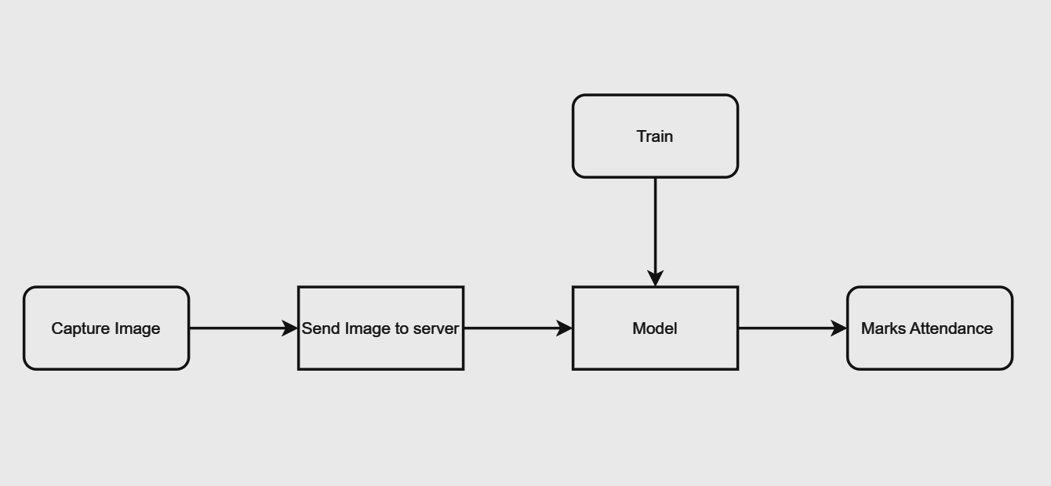
Work Flow Diagram

Slide 9
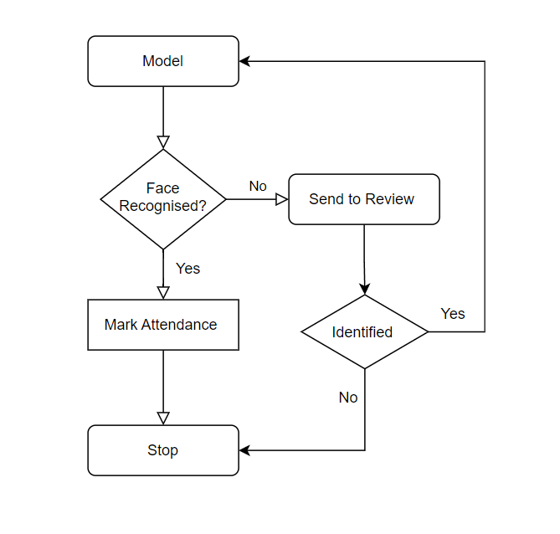

Slide 10
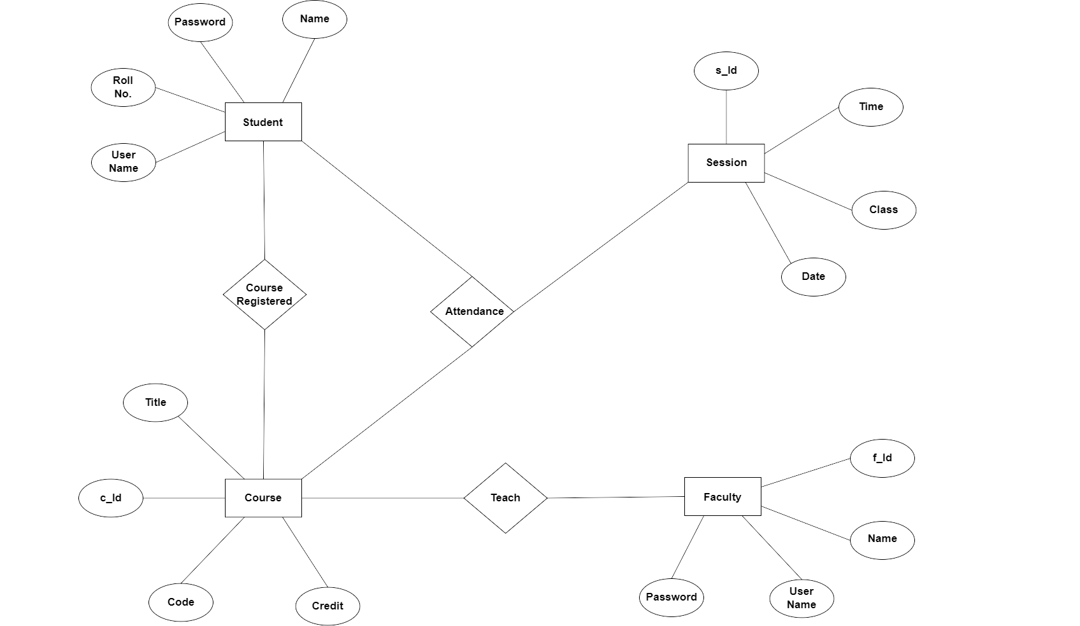
ER Diagram

Slide 11








Tech Stack

Slide 12
Thank You
Group 11

